Slide 1
Threads vs. Processes
April 7, 2000
Instructor: Gary Kimura
Slides courtesy of Hank Levy
Notes:
1

Slide 2
Processes and Threads
A full process includes numerous things:
  an address space (defining all the code and data pages)
  OS resources and accounting information
  a “thread of control”, which defines where the process is currently executing (basically, the PC and registers)
Creating a new process is costly, because of all of the structures (e.g., page tables) that must be allocated
Communicating between processes is costly, because most communication goes through the OS

Slide 3
Parallel Programs
Suppose I want to build a parallel program to execute on a multiprocessor, or a web server to handle multiple simultaneous web requests. I need to:
  create several processes that can execute in parallel
  cause each to map to the same address space (because they’re part of the same computation)
  give each its starting address and initial parameters
  the OS will then schedule these processes, in parallel, on the various processors
Notice that there’s a lot of cost in creating these processes and possibly coordinating them. There’s also a lot of duplication, because they all share the same address space, protection, etc……

Slide 4
“Lightweight” Processes
What’s similar in these processes?
  They all share the same code and data (address space)
  they all share the same privileges
  they share almost everything in the process
What don’t they share?
  Each has its own PC, registers, and stack pointer
Idea: why don’t we separate the idea of process (address space, accounting, etc.) from that of the minimal “thread of control” (PC, SP, registers)?

Slide 5
Threads and Processes
Some newer operating systems (Mach, Chorus, NT) therefore support two entities:
  the process, which defines the address space and general process attributes
  the thread, which defines a sequential execution stream within a process
A thread is bound to a single process. For each process, however, there may be many threads.
Threads are the unit of scheduling; processes are containers in which threads execute.

Slide 6
How different OSs support threads
= address space
= thread
example: MS/DOS
example: Unix
example: Xerox Pilot
example: Mach, OSF, Chorus, NT

Slide 7
Separation of Threads and Processes
Separating threads and processes makes it easier to support multi-threaded applications
Concurrency (multi-threading) is useful for:
  improving program structure
  handling concurrent events (e.g., web requests)
  building parallel programs
So, multi-threading is useful even on a uniprocessor.
But, threads, even when supported separately from processes in the kernel, are too slow.

Slide 8
Kernel Threads
Kernel threads still suffer from performance problems.
Operations on kernel threads are slow because:
  a thread operation still requires a kernel call
  kernel threads may be overly general, in order to support needs of different users, languages, etc.
  the kernel doesn’t trust the user, so there must be lots of checking on kernel calls

Slide 9
User-Level Threads
To make threads really fast, they should be implemented at the user level
A user-level thread is managed entirely by the run-time system (user-level code that is linked with your program).
Each thread is represented simply by a PC, registers, stack and a little control block, managed in the user’s address space.
Creating a new thread, switching between threads, and synchronizing between threads can all be done without kernel involvement.

Slide 10
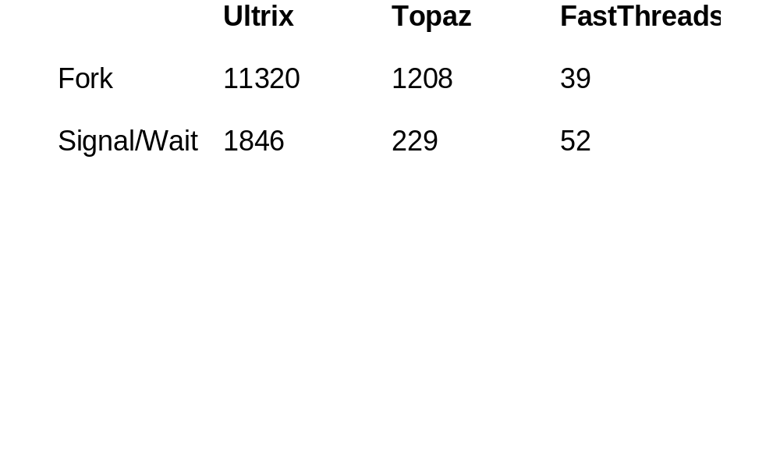
(Old) Example of thread performance
(perf. on a 3 MIPs processor)
Ultrix: 1 thread per address space
Topaz: multiple threads per address space
FastThreads: multiple user threads per address space

Slide 11
Example U-L Thread Interface
t = thread_fork(initial context)
  create a new thread of control
  sometimes show as
    thread_create(), thread_setstate(initial context)
thread_stop()
  stop the calling thread, sometimes called thread_block
thread_start(t)
  start the named thread
thread_yield()
  voluntarily give up the processor
thread_exit()
  terminate the calling thread, sometimes called thread_destroy.

Slide 12
Key Data Structures
your process address space
your program:
your data (shared by
all your threads):
for i (1, 10, I++)
thread_fork(I);
….
queue of thread control blocks
user-level thread code:
proc thread_fork()…
proc thread_block()…
proc thread_exit()...
per-thread stacks

Slide 13
User-Level Theads: Implementation
Kernel processes
kernel
process ready queue
U-L thread schedulers
user
thread ready queue
current threads
thread ready queue

Slide 14
Threads
The OS is a huge multi-threaded program.
Multi-threading is useful for applications as well.
User-Level threads can be 100x faster than similar kernel thread operations.
But user-level threads suffer from a problem of poor integration; because they’re invisible to the OS, the OS can make poor scheduling decisions, e.g.:
  running a process that has no work (is running an idle thread)
  blocking a process whose u-l thread has requested I/O, even though other threads can run in that process
  removing a process whose u-l thread is holding a lock
Solving this requires communication between the kernel and the u-l thread manager.

